Slide 1
Pointer

Slide 2
Pointer
A pointer is a variable that stores the location of memory.
In more fundamental terms, a pointer stores the address of a variable.
For example:
int *p , q;
p=&q;

Slide 3
Why Pointers?
To modify a variable in a function that is not a global, or a local to that function.
To save space
To save time
To use dynamic memory
Used extensively in linked structures

Slide 4
Declaration of pointer
A pointer has to be declared just like any other variable.
For example:
int *p; (It is a pointer to an integer)
float *q; (It is a pointer to an float)
char *p; (It is a pointer to an char)

Slide 5
OR
Like any variable or constant, you must declare a pointer before you can use it to store any variable address.

Slide 6
Declaration of Pointer Variables
Type *pointerVarName;
The * before the pointerVarName indicates that this is a pointer variable, not a regular variable
The * is not a part of the pointer variable name
Some valid pointer declaration:
int *inp; // pointer to an integer
char *chp // pointer to a character
double *dp; // pointer to a double
float *flp; // pointer to a float

Slide 7
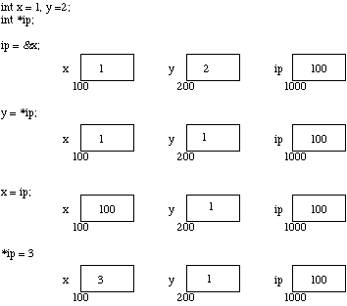

Slide 8
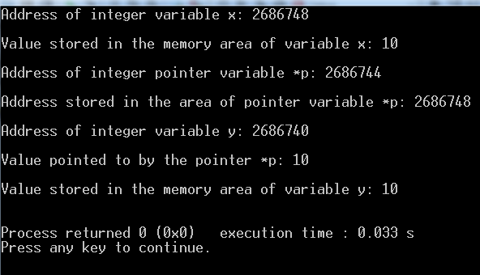
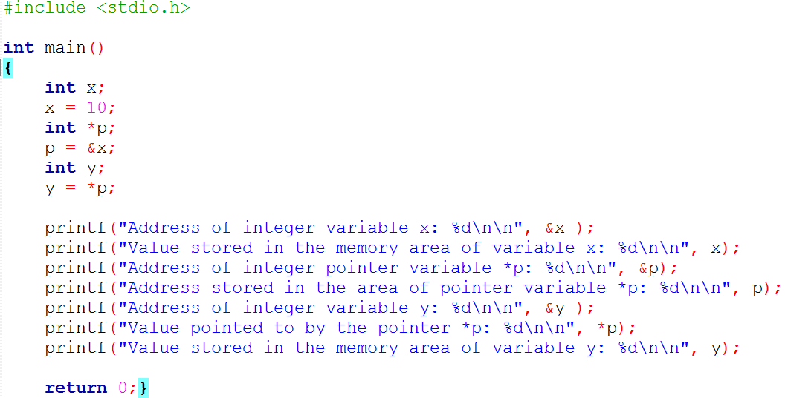

Slide 9
Assignment of Pointer Variables (Cont ..)
float data = 50.8;
float *ptr;
ptr = &data;
FFF0
FFF1
FFF2
FFF3
data
FFF4
50.8
FFF5
FFF6
9

Slide 10
Assignment of Pointer Variables (Cont ..)
float data = 50.8;
float *ptr;
ptr = &data;
ptr
FFF0
FFF1
FFF2
FFF3
data
FFF4
50.8
FFF5
FFF6
10

Slide 11
Assignment of Pointer Variables (Cont ..)
float data = 50.8;
float *ptr;
ptr = &data;
ptr
FFF0
FFF4
FFF1
FFF2
FFF3
data
FFF4
50.8
FFF5
FFF6
11

Slide 12
Assignment of Pointer Variables (Cont ..)
Don’t try to assign a specific integer value to a pointer variable since it can be disastrous
float *ptr;
ptr = 120; //This is wrong.
h they are both integrals
float data = 50.0;
float *ptr;
ptr = &data; //This is valid

Slide 13
Initializing pointers
A pointer can be initialized during declaration by assigning it the address of an existing variable
float data = 50.8;
float ptr = &data;
If a pointer is not initialized during declaration, it is wise to give it a NULL (0) value
float *fp = NULL;
13

Slide 14
Dereferencing
Dereferencing – Using a pointer variable to access the value stored at the location pointed by the variable
Provide indirect access to values and also called indirection
Done by using the dereferencing operator * in front of a pointer variable
Unary operator

Slide 15
 |  |  | &x represents the memory area of variable named x. |  |  |  |  | &p represents the memory area of variable named *p.
int x; |  |  | x represents the value stored inside the area of variable named x. |  | int *p; |  |  | p represents the address stored inside the area of variable named *p.
 |  |  |  |  |  |  |  | *p represents the value stored in the area represented/pointed to by address p.

Slide 16
Dereferencing (Cont ..)
Example:
float data = 50.8;
float *ptr;
ptr = &data;
cout << *ptr;
Once the pointer variable ptr has been declared, *ptr represents the value pointed to by ptr.
OUTPUT:
50.8

Slide 17
Dereferencing (Cont ..)
The dereferencing operator * can also be used in assignments.
*ptr = 200;
Make sure that ptr has been properly initialized
float data;
float *ptr;
ptr = &data;
*ptr = 200;
cout << *ptr;
OUTPUT:
200

Slide 18
Dereferencing Example
#include <iostream.h>
void main()
{
float data = 50.8;
float *ptr;
ptr = &data;
cout << ptr << *ptr << endl;
*ptr = 27.4;
cout << *ptr << endl;
cout << data << endl;
}
Output:
ptr
FFF0
FFF4
FFF1
FFF2
FFF3
data
FFF4
50.8
FFF5
FFF6

Slide 19
Dereferencing Example (Cont ..)
#include <iostream.h>
void main()
{
float data = 50.8;
float *ptr;
ptr = &data;
cout << ptr <<“ ”<< *ptr << endl;
*ptr = 27.4;
cout << *ptr << endl;
cout << data << endl;
}
OUTPUT:
FFF4 50.8
ptr
FFF0
FFF4
FFF1
FFF2
FFF3
data
FFF4
50.8
FFF5
FFF6

Slide 20
Dereferencing Example (Cont ..)
#include <iostream.h>
void main()
{
float data = 50.8;
float *ptr;
ptr = &data;
cout << ptr <<“ ”<< *ptr << endl;
*ptr = 27.4;
cout << *ptr << endl;
cout << data << endl;
}
OUTPUT:
FFF4 50.8
ptr
FFF0
FFF4
FFF1
FFF2
FFF3
data
FFF4
27.4
FFF5
FFF6

Slide 21
Dereferencing Example (Cont ..)
#include <iostream.h>
void main()
{
float data = 50.8;
float *ptr;
ptr = &data;
cout << ptr << *ptr << endl;
*ptr = 27.4;
cout << *ptr << endl;
cout << data << endl;
}
OUTPUT:
27.4
ptr
FFF0
FFF4
FFF1
FFF2
FFF3
data
FFF4
27.4
FFF5
FFF6

Slide 22
Dereferencing Example (Cont ..)
#include <iostream.h>
void main()
{
float data = 50.8;
float *ptr;
ptr = &data;
cout << ptr << *ptr << endl;
*ptr = 27.4;
cout << *ptr << endl;
cout << data << endl;
}
OUTPUT
27.4
ptr
FFF0
FFF4
FFF1
FFF2
FFF3
data
FFF4
27.4
FFF5
FFF6

Slide 23
// more pointers
#include <iostream>
using namespace std;
int main ()
{
int firstvalue = 5, secondvalue = 15;
int * p1, * p2;
p1 = &firstvalue; // p1 = address of firstvalue
p2 = &secondvalue; // p2 = address of secondvalue
*p1 = 10; // value pointed to by p1 = 10
*p2 = *p1; // value pointed to by p2 = value pointed by p1
p1 = p2; // p1 = p2 (value of pointer is copied)
*p1 = 20; // value pointed by p1 = 20
cout << "firstvalue is " << firstvalue << '\n';
cout << "secondvalue is " << secondvalue << '\n';
return 0;
}

Slide 24
// more pointers
#include <iostream>
using namespace std;
int main ()
{
int firstvalue = 5, secondvalue = 15;
int * p1, * p2;
p1 = &firstvalue; // p1 = address of firstvalue
p2 = &secondvalue; // p2 = address of secondvalue
*p1 = 10; // value pointed to by p1 = 10
*p2 = *p1; // value pointed to by p2 = value pointed by p1
p1 = p2; // p1 = p2 (value of pointer is copied)
*p1 = 20; // value pointed by p1 = 20
cout << "firstvalue is " << firstvalue << '\n';
cout << "secondvalue is " << secondvalue << '\n';
return 0;
}
firstvalue is 10
secondvalue is 20

Slide 25
Basic Pointer Arithmetic
0x2008
0x200C
0x2010
0x2014
0x2018
array:
0x2008
0
1
2
3
4
pPtr:
qPtr:
0x2008
NULL
0x2004
0x2000
float array[5];
float* pPtr = array;
float* qPtr = NULL;

Slide 26
0x2008
0x200C
0x2010
0x2014
0x2018
array:
0x2008
0
1
2
3
4
pPtr:
qPtr:
0x200C
NULL
0x2004
0x2000
float array[5];
float* pPtr = array;
float* qPtr = NULL;
pPtr++; /* pPtr now holds the address: &array[1] */

Slide 27
0x2008
0x200C
0x2010
0x2014
0x2018
array:
0x2008
0
1
2
3
4
pPtr:
qPtr:
0x2018
NULL
0x2004
0x2000
float array[5];
float* pPtr = array;
float* qPtr = NULL;
pPtr++; /* pPtr = &array[1] */
pPtr += 3; /* pPtr now hold the address: &array[4] */

Slide 28
0x2008
0x200C
0x2010
0x2014
0x2018
array:
0x2008
0
1
2
3
4
pPtr:
qPtr:
0x2018
0x2010
0x2004
0x2000
float array[5];
float* pPtr = array;
float* qPtr = NULL;
pPtr++; /* pPtr = &array[1] */
pPtr += 3; /* pPtr = &array[4] */
qPtr = array + 2; /*qPtr now holds the address &array[2]*/

Slide 29
0x2008
0x200C
0x2010
0x2014
0x2018
array:
0x2008
0
1
2
3
4
pPtr:
qPtr:
0x2018
0x2010
0x2004
0x2000
float array[5];
float* pPtr = array;
float* qPtr = NULL;
pPtr++; /* pPtr = &array[1] */
pPtr += 3; /* pPtr = &array[4] */
qPtr = array + 2; /* qPtr = &array[2] */
Cout<< pPtr-qPtr;

Slide 30
POINTERS & ARRAYS:
An alternative idea of an array is to consider it as simply a block of memory.
An array can be accessed with pointers as well as with [] square brackets.
The name of an array variable, standing alone, is actually a pointer to the first element in the array.
So, any operation that can be achieved by array subscripting can also be done with pointers or vice-versa.

Slide 31
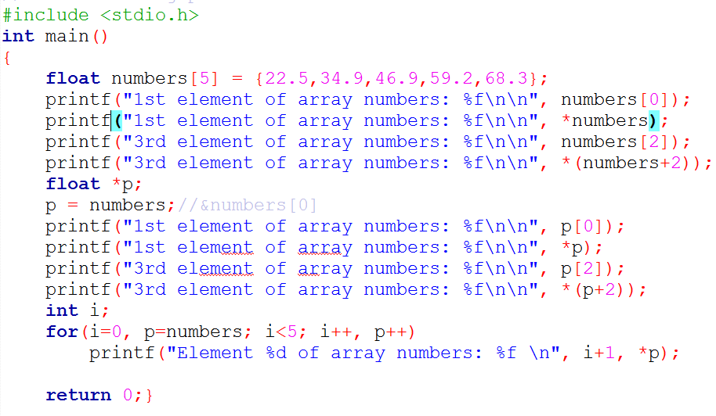

Slide 32
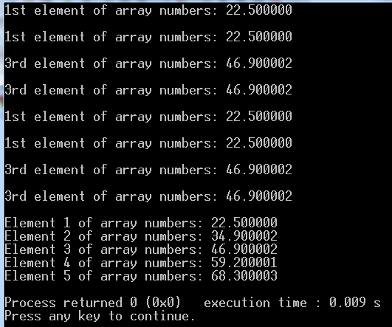
Output of the previous program

Slide 33
numbers |  |  |  |  |  |  |  |  |  |  |  | numbers+2
 |  |  |  |  |  |  |  |  |  |  |  |  |  |  |  |  |  |  |  |  |  |  |  |  |  |  |  |  |  |  | 123472
 |  |  |  | 123456 |  |  | 0 |  |  |  |  |  |  |  |  |  |  |  | 1 |  |  |  |  |  |  |  |  |  |  |  |  |  | 2 |  |  |  |  |  |  |  | 3 |  |  |  |  |  |  |  |  | 4
 |  |  |  |  |  |  | 22.5 |  |  |  |  |  |  |  |  |  |  |  | 34.8 |  |  |  |  |  |  |  |  |  |  |  | 46.8 |  |  |  |  |  |  |  |  |  | 59.1 |  |  |  |  |  |  |  |  | 68.3
 |  |  |  |  |  |  |  |  | double size |  |  |  |  |  |  |  |  |  |  |  | p+2
 |  |  |  |  |  |  |  |  |  |  |  |  |  |  |  |  |  |  |  |  |  |  |  |  |  |  |  |  |  |  | 123472
p

Slide 34
pointer value + n = pointer value + n * (sizeof(data type)).
Assuming the starting address of the array numbers is 123456
numbers[0] starts at address,
numbers + 0 * sizeof (double) = 123456+0*8 = 123456,
numbers[1] starts at address,
numbers+ 1 * sizeof (double) = 123456+1*8 = 123464,
numbers[2] starts at address,
numbers+ 2 * sizeof (double) = 123456+2*8 = 123472.

Slide 35
Remember this…
When a pointer value is increased by a number n, it actually increases by n*sizeof(data type)number of bytes.

Slide 36
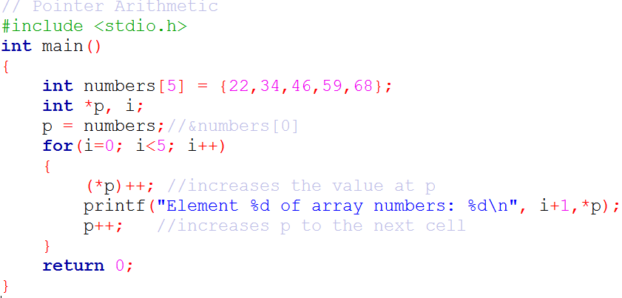

Slide 37
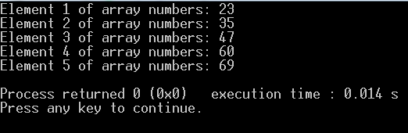
Output of the previous program

Slide 38
Passing pointers to a function

Slide 39
#include <iostream>
void fakeSwap(int a, int b)
{
int tmp;
tmp = a;
a = b;
b = tmp;
}
int main()
{
int x = 1, y = 2;
fakeSwap(x, y);
cout << x << " " << y << endl;
}
Solution 1

Slide 40
#include <iostream >
void fakeSwap(int a, int b)
{
int tmp;
tmp = a;
a = b;
b = tmp;
}
int main()
{
int x = 1, y = 2;
fakeSwap(x, y);
cout << x << " " << y << endl;
}
Solution 1
x:
1
0x2000
y:
2
0x2010

Slide 41
#include < iostream >
void fakeSwap(int a, int b)
{
int tmp;
tmp = a;
a = b;
b = tmp;
}
int main()
{
int x = 1, y = 2;
fakeSwap(x, y);
cout << x << " " << y << endl;
}
Solution 1
tmp:
0x2060
a:
1
0x2038
b:
2
0x2040
x:
1
0x2000
y:
2
0x2010

Slide 42
#include < iostream >
void fakeSwap(int a, int b)
{
int tmp;
tmp = a;
a = b;
b = tmp;
}
int main()
{
int x = 1, y = 2;
fakeSwap(x, y);
cout << x << " " << y << endl;
}
Solution 1
tmp:
1
0x2060
a:
1
0x2038
b:
2
0x2040
x:
1
0x2000
y:
2
0x2010

Slide 43
#include < iostream >
void fakeSwap(int a, int b)
{
int tmp;
tmp = a;
a = b;
b = tmp;
}
int main()
{
int x = 1, y = 2;
fakeSwap(x, y);
cout << x << " " << y << endl;
}
Solution 1
tmp:
1
0x2060
a:
2
0x2038
b:
2
0x2040
x:
1
0x2000
y:
2
0x2010

Slide 44
#include < iostream >
void fakeSwap(int a, int b)
{
int tmp;
tmp = a;
a = b;
b = tmp;
}
int main()
{
int x = 1, y = 2;
fakeSwap(x, y);
cout << x << " " << y << endl;
}
Solution 1
tmp:
1
0x2060
a:
2
0x2038
b:
1
0x2040
x:
1
0x2000
y:
2
0x2010

Slide 45
#include < iostream >
void fakeSwap(int a, int b)
{
int tmp;
tmp = a;
a = b;
b = tmp;
}
int main()
{
int x = 1, y = 2;
fakeSwap(x, y);
cout << x << " " << y << endl;
}
Solution 1
x:
1
0x2000
y:
2
0x2010

Slide 46
#include < iostream >
void trueSwap(int* a, int* b)
{
int tmp;
tmp = *a;
*a = *b;
*b = tmp;
}
int main()
{
int x = 1, y = 2;
trueSwap(&x, &y);
cout << x << " " << y << endl;
}
Solution 2

Slide 47
#include < iostream >
void trueSwap(int* a, int* b)
{
int tmp;
tmp = *a;
*a = *b;
*b = tmp;
}
int main()
{
int x = 1, y = 2;
trueSwap(&x, &y);
cout << x << " " << y << endl;
}
Solution 2
x:
1
0x2000
y:
2
0x2010

Slide 48
#include < iostream >
void trueSwap(int* a, int* b)
{
int tmp;
tmp = *a;
*a = *b;
*b = tmp;
}
int main()
{
int x = 1, y = 2;
trueSwap(&x, &y);
cout << x << " " << y << endl;
}
Solution 2
tmp:
0x2060
a:
addr of x
0x2038
b:
addr of y
0x2040
x:
1
0x2000
y:
2
0x2010

Slide 49
#include < iostream >
void trueSwap(int* a, int* b)
{
int tmp;
tmp = *a;
*a = *b;
*b = tmp;
}
int main()
{
int x = 1, y = 2;
trueSwap(&x, &y);
cout << x << " " << y << endl;
}
Solution 2
tmp:
1
0x2060
a:
addr of x
0x2038
b:
addr of y
0x2040
x:
1
0x2000
y:
2
0x2010

Slide 50
#include < iostream >
void trueSwap(int* a, int* b)
{
int tmp;
tmp = *a;
*a = *b;
*b = tmp;
}
int main()
{
int x = 1, y = 2;
trueSwap(&x, &y);
cout << x << " " << y << endl;
}
Solution 2
tmp:
1
0x2060
a:
addr of x
0x2038
b:
addr of y
0x2040
x:
2
0x2000
y:
2
0x2010

Slide 51
#include < iostream >
void trueSwap(int* a, int* b)
{
int tmp;
tmp = *a;
*a = *b;
*b = tmp;
}
int main()
{
int x = 1, y = 2;
trueSwap(&x, &y);
cout << x << " " << y << endl;
}
Solution 2
tmp:
1
0x2060
a:
addr of x
0x2038
b:
addr of y
0x2040
x:
2
0x2000
y:
1
0x2010

Slide 52
#include < iostream >
void trueSwap(int* a, int* b)
{
int tmp;
tmp = *a;
*a = *b;
*b = tmp;
}
int main()
{
int x = 1, y = 2;
trueSwap(&x, &y);
cout << x << " " << y << endl;
}
Solution 2
x:
2
0x2000
y:
1
0x2010

Slide 53
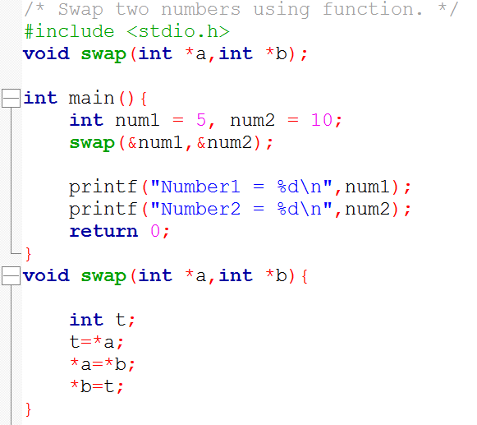
Pointers & Functions

